Slide 1

Linear Regression Concepts

Slide 2
What is Linear Regression?
A linear approach to model relationship between variables used for predicting continuous output. The algorithm is fast, and used at early stage.
The model is represented with a line of equation
y= ax+b
The values a and b are aggregated from the data based on the sum of least squares.

Slide 3
A Sample Correlation

Slide 4
Fitting a line Across Data

Slide 5
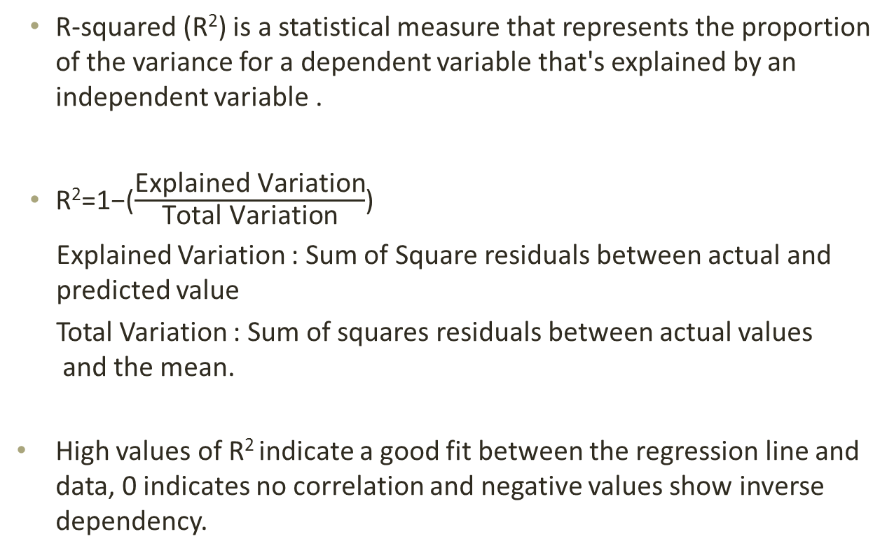
Calculating R²
R-squared (R²) is a statistical measure that represents the proportion of the variance for a dependent variable that's explained by an independent variable .
​R²=1−($\frac{\text{Explained} \text{Variation}\text{​​}}{\text{Total} \text{Variation}}$)
Explained Variation : Sum of Square residuals between actual and predicted value
Total Variation : Sum of squares residuals between actual values and the mean.
High values of R² indicate a good fit between the regression line and data, 0 indicates no correlation and negative values show inverse dependency.

Slide 6
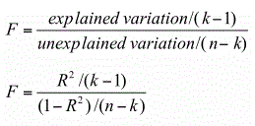
Finding p value for R²
To make a good decision we need to find the statistical significance of p value.
Here n is the total number of observations and k is the number of independent variables
The p value can be found from the F statistic table for the given degrees of freedom.

Slide 7
Tutorials for Statistics behind Linear Regression.
Khan Academy
https://www.khanacademy.org/math/statistics-probability/describing-relationships-quantitative-data/regression-library/
Statquest Youtube Channel
https://youtu.be/nk2CQITm_eo

Slide 8
Code Library
Get the data first.
https://github.com/Aninditasg/Machine-Learning-with-Code---Linear-Regression/tree/master/data/

Slide 9
Code Library
Get the Python Code .
https://github.com/Aninditasg/Machine-Learning-with-Code---Linear-Regression/
Linear Regression.ipynb
Other Implementations.
R , Python, Spark(mllib), Azure

Slide 10
Industrial Applications of Linear Regression
Retail Industry : Dynamic Pricing
Risk Estimation
Stock Price Prediction
Drug Response
Consumer Behaviour

Slide 11
Questions

